Slide 1
Pronouns in English
Subject pronouns and possessive adjective pronouns

Slide 2
LOOK AT THE EXAMPLES:
MY MOTHER IS A VERY GOOD MOM.
(SHE)
MY FATHER IS A GREAT FATHER.
(HE)
MY PARENTS ARE VERY HAPPY WITH MY GRADES.
(THEY)
THOMAS AND I ARE VERY GOOD FRIENDS.
(WE)
THE TABLE IS DIRTY. / THE TABLES ARE DIRTY.
(IT) (THEY)
Subject pronouns: are the ones that substitute the person o persons, or thing(s) or animal(s) who do the action

Slide 3

MY NAME IS THOMAS, I AM ADOPTED.
THIS IS MY NEW FAMILY
MARCO IS MY LITTLE BROTHER.
(HE)
MARY AND MIKE ARE MY SIBLINGS.
(SHE) & (HE)
(THEY)
LOOK AT MORE EXAMPLES:

Slide 4

Singular pronouns
Subject pronouns:
I
You
He
She
It
Possessive Adjectives:
My
Your
His
Her
its
Subject & adjective pronouns:
+ a noun
Plural pronouns
Subject pronouns:
You
We
They
Possessive Adjectives:
Your
Our
Their
+ a noun

Slide 5
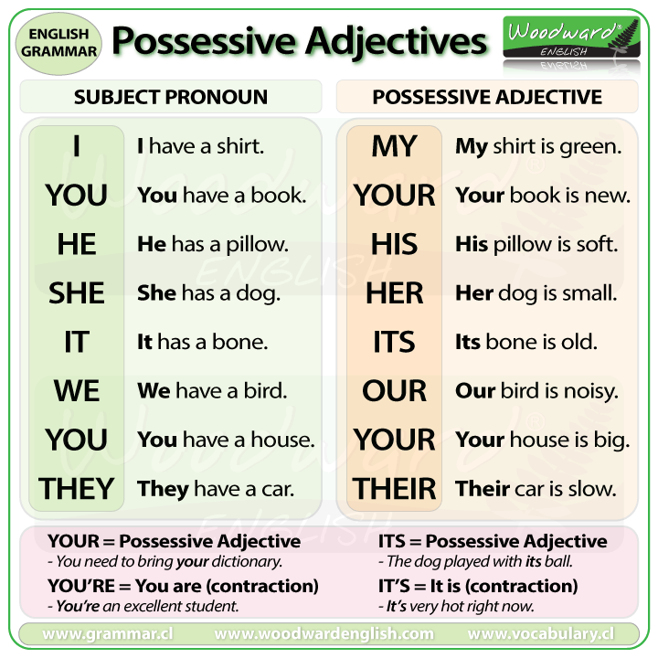

Slide 6

Adjective pronouns: are used to talk about belonging
Hello.
My name is Nelly
This is my new soccer ball.
She is my mom.
Her name is Doris
Her hair is brown, but my hair is blonde.
Her eyes are blue and my eyes are blue too.
Her blouse is fuchsia color.

Slide 7
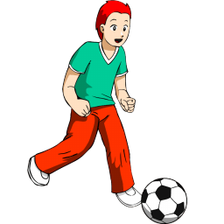
Let me introduce my Friend:
This is my friend Robert.
His nickname is Bob.
His hair is red.
His t-shirt is green.
His pants are Brown.
He is a good soccer player.
This is his new ball.

Slide 8

Let me introduce my Friend:
She is my friend Elizabeth.
Her nickname is Lisa.
Her hair is blonde.
Her sport suit is purple.
She is a good cyclist .
This is her new bicycle.

Slide 9
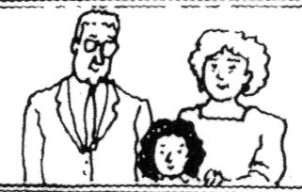
Let me introduce my grandparents:
They are my grandparents Elizabeth and Thomas.
Their nicknames are Betsy and Tom.
Their hair is gray.
They are lovely.
Their house is close to my house so I go there every day.
I am here.
This is their photograph.

Slide 10
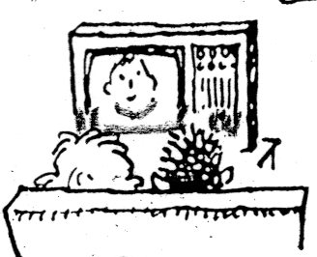
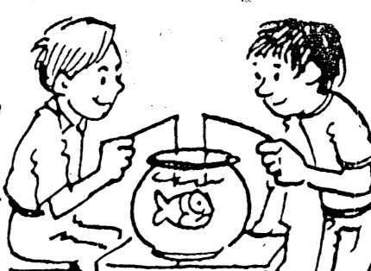
These are me and my brother:
Our names are Michael and Edward.
Our nicknames are Mike and Ted.
We are very good brothers.
This is our TV.
We love to go fishing. So… this is our Aquarium and that is our fish.
These are our photographs doing different activities.
Mike
Ted

Slide 11

This is my house
Its color is beige
Its roof is red
It’s a nice house
It’s in a safe neighborhood
Its garden is beautiful
Its porch is in front of the house
I love my house.

Slide 12
Let’s practice:
Complete the sentences with the correct pronoun:

Slide 13
1. ( She / Her ) is ( I / my ) mother.
2. ( They / Their ) are children.
3. ( It / Its ) is ( I / my ) house.
4. That is ( they / their ) shampoo.
5. Is ( you / your ) name Maria?
6. Are ( we / our ) classes today?
7. Is ( she / her ) familly happy?
8. ( He / His ) is a good friend.
9. ( He / His ) is ( we / our ) best friend.
10. ( It / Its ) isn’t ( she / her ) favorite movie.
Choose the Word in parentheses that completes the sentence correctly

Slide 14

Great job!

